Slide 1
Load Test Client
Jarveis Lam, Tng Yee Fong
Notes:
Hello! Im Jarveis and with me is Yee Fong. So we will be presenting on one of the project we have been working on over the past 2/3 months which is the Load Test Client

Slide 2
Agenda
1
2
3
4
Problem Statement
Proposed Solution
Challenges and Learning Points
Demo
Notes:
A brief agenda on
Prob Stmt and why we built the LTC
The proposed solution and structure of the LTC
Some chlg and lp from this entire project
And a short demo on the functionality

Slide 3
Problem Statement
Load Test Client

Slide 4



Problem Statement
New microservices are developed
Are they stable and reliable?
Efficient and fast?
How do we validate their performance?
Testing
Create test data?
Ensure correct inputs?
Ensure service running?
Impact
Tedious and time consuming
Lot of effort
Need to repeat tests for each new microservice
Source placeholder
Notes:
We are transforming our technology, and in part of that is creating new microservices. We need to ensure that new microservices that are being developed perform well and as intended. We need to ensure that they are stable and reliable, efficient and fast. We need to be able to validate their performance before being confident in using them in the real world.
Therefore, we need to test. Performing load tests which help to validate these services by simulating concurrent runs with a high number of users. This requires some effort though. We need to create mock test data to run this load test. We will need to ensure that the inputs are correct for a specific run, and we need to ensure that the service is in fact running.
What’s the impact of this? The current way we perform load tests is not intuitive as it requires users to manually set up inputs and create test data and run the test.
This incurs unnecessary time wastage and effort to developers and teams.
As new microservices are constantly developed, we will need to continually test their performance and reliability.
PARALLEL

Slide 5
Problem Statement
Load testing new microservices is a tedious and cumbersome process. As we transform our … , we need to ensure that microservices are stable and reliable. Performing load tests which help to validate these services by simulating concurrent runs with a high number of users.
However, triggering these load tests however is not intuitive and requires users to manually set up inputs and create test data.
This incurs unnecessary time wastage to developers and teams, and as new microservices are constantly developed, we will need to continually test their performance and reliability.

Slide 6

Problem Statement
Performing Load Tests
=
Tedious & Unintuitive
Notes:
As such, we can see that the current methods to load test may not be the best for the team’s efficiency and productivity. Time can be better spent developing and ensuring that these services are in fact up to standard, rather than spending the time configuring and manually triggering parallel tests

Slide 7
Proposed Solution
Load Test Client

Slide 8
Proposed Solution
1
2
3
Creation of UI for Load Test Tool
Enhance method to run load test through creation of UI.
Users can curate their choice of application, process, database and server and input the relevant pre-edit and partition numbers they would like to run.
Data Generation
Search for application tables.
Automate the process of data generation instead of manually creating data.
Load Test Service
Parallel trigger the microservices APIs with multiple datasets
Source placeholder
Notes:
A frontend platform for users to access and utilize the tool
Can input their settings, test data or generate data as required
And trigger the load test
Search for app tables
Automatically creates the test data for users to use in the load test
3) load test service -> triggering the api parallely

Slide 9
User Flow
Inserts new pre-edit and partition numbers input boxes
Yes
Add more set of numbers?
No
Input pre-edit and partition numbers
No
Start
Need to generate data?
Run Load Test
Select application, process, database and server for microservice
Yes
Input pre-edit, partition numbers and number of threads
Input pre-edit, partition numbers and number of threads

Slide 10





Tech Stack and Client Structure
Frontend
Backend
DB2
React JS
Generate Data Controller
Generate Data Service
Microservices
Load Test Controller
Invoke Load Test Tool
Trigger Load Test & Microservice

Slide 11
Data Flow – Generate Data
Application | Process | Table
CORE | Summarization | VTI_EDIT_PAKS
 | Pre-Edit | VTI_BKEND_SUMMZN VTI_BKEND_PST_SUMMZN
 | Post Summarization
CONFIG | Summarization | VTI_EDIT_PAKS
 | Pre-Edit | VTI_BKEND_SUMMZN VTI_BKEND_CNFG_PST_SUMMZN
 | Post Summarization
List of Edit Tables:
[VB2_CLRNG_BUS_E, …]
Notes:
Do for different processes -> created in different tables -> Summzn -> Edit Paks -> pre-edit -> Config/ core -> VB2-VTI -> go slow

Slide 12
Data Flow – Generate Data
Generate new Pre-edit Numbers
Input:
Pre-edit No: 267
Partition No: 11
No. of Threads: 4
List of Edit Tables:
[VB2_CLRNG_BUS_E, …]
VTI_CHG_CNTL
New Pre-edit and Partition Numbers
Insert into
List of Edit Tables
And VTI_EDIT_PAKS
PEDIT_NUM:
314
314
317
List of new PEDIT_NUM:
315, 316, 317

Slide 13
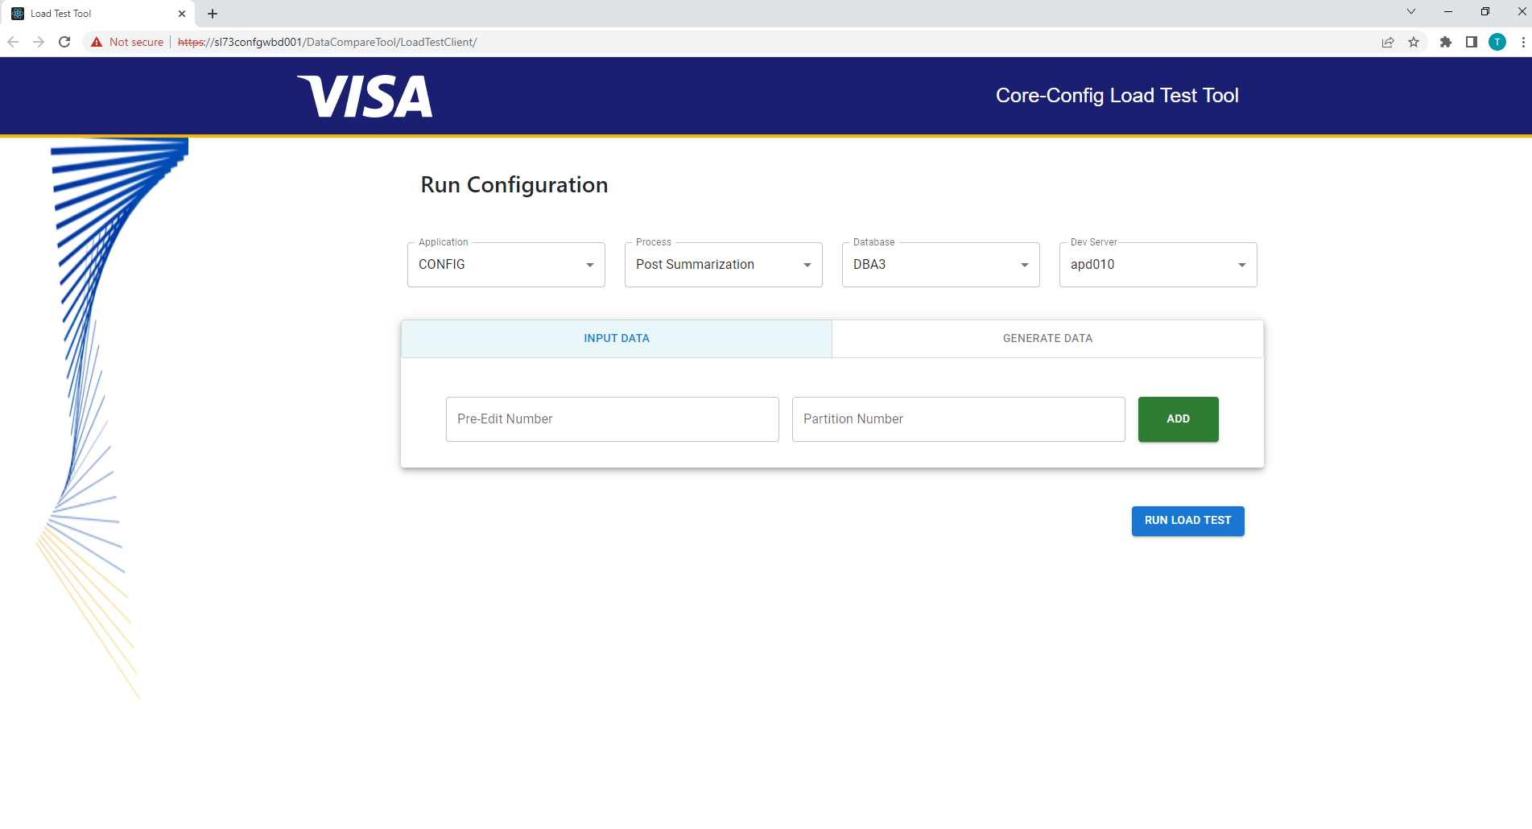
Data Flow – Run Load Test
Load Test Tool
Example of data passed from frontend
{"generalConfigurations":
{"application":["CONFIG","CORE"],
"process":“Summarisation","db":"DBA9"},
"isDataNeeded":false,
"devServer":"apd010",
"datalist":[{"peditNo":776,"ptnNo":8},{"peditNo":777,"ptnNo":9},{"peditNo":778,"ptnNo":10},{"peditNo":779,"ptnNo":11},{"peditNo":780,"ptnNo":12},{"peditNo":781,"ptnNo":13},{"peditNo":782,"ptnNo":14},{"peditNo":783,"ptnNo":15},{"peditNo":784,"ptnNo":16}],
"noThreads":9}
checkStatus() is called on the microservice after it is triggered
https://sl73confg<devServer>.visa.com:8270/summ/check-status
run() builds microservice url and calls api
https://sl73confg<devServer>.visa.com:8270/summ/coreconfig/invokeSummarization

Slide 14
Load Test Tool
How to use
Users can select the application, process, database and server of the microservice they are going to test on.
If users have existing pre-edit and partition numbers they would like to run, they can use the default input data toggle to input their numbers.
If users wants to generate data instead, they can switch the toggle to generate data where they input 1 set of pre-edit and partition number and the number of threads they would like to generate.
Source placeholder

Slide 15
Challenges and Learning Points
Load Test Client

Slide 16


Understanding the purpose, needs and impacts of our project.
©2021 Visa. All rights reserved. Visa Confidential
16

Slide 17
Learning Points – Lessons to take with us
1
2
3
Think Big: High Level Understanding
Know the context and use of our project
How it interacts with other areas/products in the entire system
What is its purpose?
Think Wide: What do users need
How do this project solve a users need?
Keep it simple.
Be Adaptable and Gather Feedback fast
Getting Feedback often helps to catch issues early on
Provides adequate time to change and adapt
Source placeholder
Notes:
Team –training
Requirement gathering – Prosenjit and Xunyu gave a lot of guidance for this part, helping us understand the requirement fully.
One example → we misunderstood some requirements at the start and realized 1 week before our deadline. If we check with the team constantly, this could have been avoided.

Slide 18
Challenges & Learning Points
1
2
3
4
Understanding requirements
Lack of understanding on system of config initially.
Learning new technology
React, Nodejs, Asynchronous functions
Understanding processes involved
How the microservices work, what results it returns.
Understanding database
Table names, structure and use.
5
6
7
8
Debugging
Understanding the log errors encountered
Use of new softwares
MobaXterm
Testing
Encountered different issues when testing in local vs in production
Deployment

Slide 19
Demo
Load Test Client
Subtitle here only if needed

Slide 20
Notes:
With that, we have come to the end of our presentation. Before moving into Q and A, jarveis and i would like to take this opportunity to thank the team for their support throughout our project. They have been really approachable which made it easy for us when we require help from them. The team has also put in extra effort in organising trainings for us and has done an amazing job in helping us understand the responsibilities of the team more. We really enjoy how inclusive the team's culture is. We may be here for only a few months but we feel very blended into this big family. We also values how the team communicates openly all the time creating a very comfortable working environment.

